Slide 1
Using ML in Data Management Systems at AWS
Vikram Nathan
Amazon Web Services
Disclaimer: The following slides do not represent views of AWS in any way

Slide 2
ML has infiltrated all levels of the DB
User Interfaces
Query gen [1]
Debugging [2]
Provisioning
Intelligent scaling [3]
Warmpool sizing [6]
Scheduling
Auto-WLM [4]
Indexing
Multi-dimensional data layouts [5]
[1] Amazon Q Generative SQL for Redshift. (https://aws.amazon.com/about-aws/whats-new/2024/09/amazon-q-generative-sql-amazon-redshift/)
[2] V. Singh, et al. Pandas: Performance Debugging for Databases using LLM Agents.
[3] V. Nathan et al. Intelligent Scaling in Amazon Redshift.
[4] G. Saxena. Auto-WLM: Machine Learning Enhanced Workload Management in Amazon Redshift.
[5] J Ding, et al. Multidimensional data layouts in Amazon Redshift.
[6] Resource Management in Aurora Serverless. https://brooker.co.za/blog/2024/07/29/aurora-serverless.html
Notes:
Machine learning has infiltrated so many levels of databases, from the user interface down to data retrieval and filtering steps. I’ve listed here a few different projects that have been implemented at AWS, mostly in Redshift but also some in RDS and Aurora.
Each of these is a paper or talk in its own right, and I’m not going to be able to do them all justice in this talk. But that’s not my goal.
I’ll focus on two parts of this diagram. I’ll briefly summarize the LLM efforts in the user interface category, and then spend a bulk of the talk discussing an application of more classical ML – intelligent scaling [3].
There are some common threads that run through how ML is used in each of these cases, LLM or not, so I want to focus the talk on those common threads.

Slide 3
Recurring Themes
ML is the future of “ease-of-use” for database systems
…BUT
ML in systems is mostly NOT about the model you use. Most of the effort is spent:
Curating instance-specific information to feed into the model. General purpose (OOB) solutions do not work!
Inaccurate outputs require extensive guardrailing
Notes:
The first thread is “ease of use” – machine learning is a key way I believe we’ll make cloud systems easier to use for customers. Easier to use can mean (a) they get up and running more quickly or (b) we can configure the database in a way that would be difficult or impossible for them to do on their own.
Our solutions that used ML typically use ML supported by heavily engineered non-ML components that do two things:
Do a lot of work to feed instance-specific information to the model. We’ve found that models, OOB or fine tuned, don’t work in isolation and are only a small part of the whole picture. A lot of the effort goes into gathering the right data to feed into the model. Using ML actually involves more work doing non-ML stuff.
Since this is ML, we have to deal with inaccurate outputs. We accomplish this by extensive guardrailing and checking, also done in non-ML land.
I’m going to talk about how this manifests in some of our ML and LLM-based features.

Slide 4
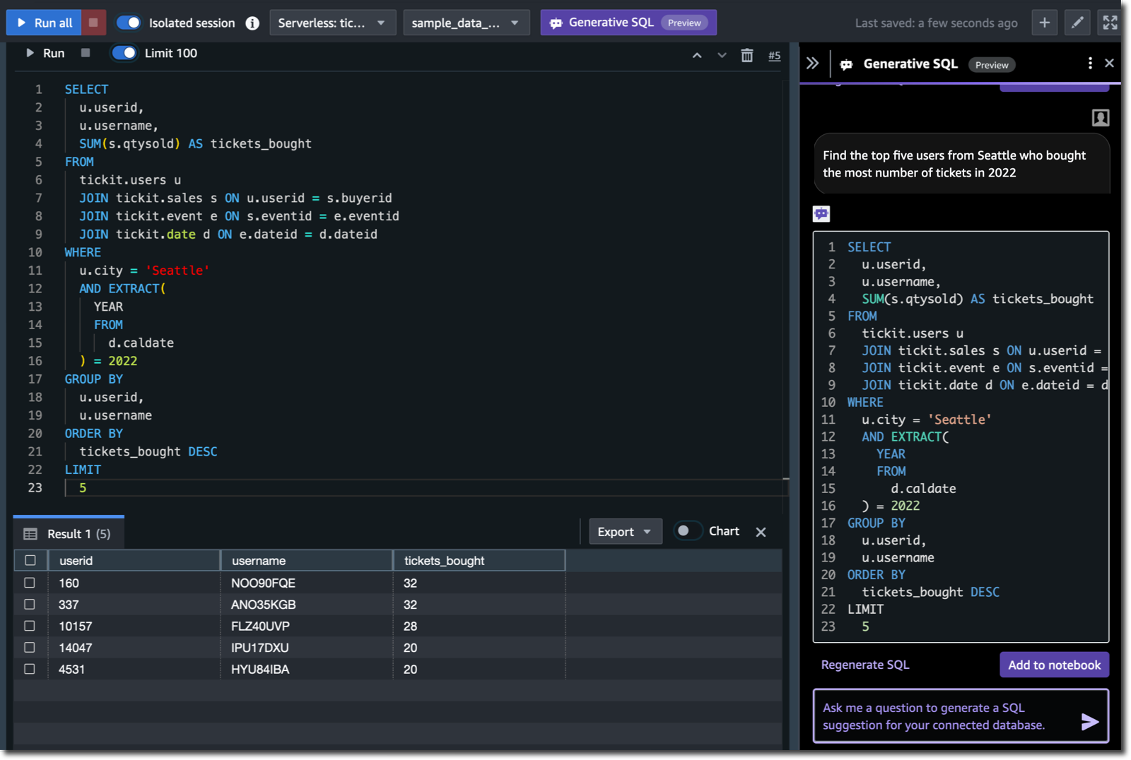
User Interfaces: NL2SQL
-
Notes:
Let’s first look at an NL2SQL application of LLMs. This is released right now in the Redshift Query editor, so feel free to play around with it. See on the right side that we have asked a question:
“Find the top five users from Seattle who bought the most number of tickets in 2022”
The editor gives you the SQL to answer your question, and as the user, you’re responsible for running it, classic human in the loop approach.

Slide 5
User Interfaces: NL2SQL
LLM prompt
Assume the following tables:
Schools(id, County, CDSCode
Satscores(cds, NumTstTakr, …)
Join Path
schools JOIN satscores ON s.CDSCode=ss.cds
Data samples:
“Alameda, CA” “Middlesex, MA”, ”Essex, MA”
Don’t talk badly about Google, Microsoft, Amazon.
Do not create update or delete statements, ….
Return SQL and no other comments for: Count the number of schools in Alameda County that have less than 100 test takers
Output
SELECT COUNT(*)
FROM schools s
JOIN satscores ss
ON s.CDSCode=ss.cds
WHERE s.County = 'Alameda, CA’
AND ss.NumTstTakr < 100
LLM
(e.g., ChatGPT,
Anthropic Opus, …)
Customer request
Count the number of schools in Alameda County that have less than 100 test takers
Self-correction loop
Post-Processing (e.g., check work, update statements, formal verification, etc.)
vector stores
Result
tables
join path
data samples
Execute query
5
Notes:
Here are some of the components that are part of this NL2SQL system. There’s a vector database, and RAG to fill the prompt with relevant context.
I want to point out the work here that’s done outside the LLM:
Guardrails done in post-processing that happens after an LLM generates a SQL output. We make sure the query is syntactically correct, using a feedback loop with the LLM until correct SQL is generated, we do checks on “dangerous” keywords like UPDATE or DELETE, and re-ask the LLM to complete the task in different ways.
When we RAG, we pull more than just tables and schema definitions into the context.

Slide 6
User Interfaces: NL2SQL
Even with RAG-ed schema information (table & column names), there is too much ambiguity for an LLM to reliably resolve.
Solution: Use past queries to provide hints (Instance-Specific Knowledge)
Sample join paths
Common filters
Columns often queried together
Join Path: {Venue.ID=Events.VenueID...}
Filters: {State: Venue.State= “MA”,
Name: Venue.Name Like “%Cinemas%”,..}
Notes:
With just schema information, there is still too much ambiguity for an LLM to reliably resolve.
This is where knowledge of production workloads comes in – production workloads are highly repetitive. Within a short while, most important columns are known, and queries tend to resemble others.
Using prior queries specific to the clusterimproved accuracy significantly.
But Using whole queries wasn’t a good idea though – they’re often redundant and clutter the context.
Instead, we distill ”hints” in the form of, for example, previously seen join paths, common filter expressions, and columns that appear in aggregations together
These hints and guardrails are what we found helps shoot the accuracy of this model much higher than what you can get with vanilla OOB or fine-tuned LLMs, and this where we spend a lot of our time and effort.

Slide 7
User Interfaces: Debugging
Out-of-the-box LLMs have general purpose knowledge, which is rarely relevant or actionable
Provides supporting evidence
Specific, actionable recommendation
Notes:
Let’s turn to a slightly more interesting (IMO) application of LLMs – a debugging assistant for when your database is running slowly.

Slide 8
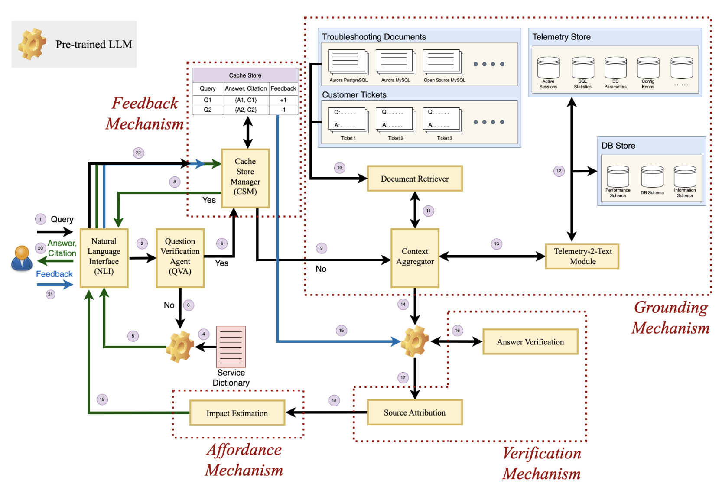
User Interfaces: Debugging
Access information not available to pre-trained model (tickets, DB schema)
Makes live query for relevant telemetry (instance-specific knowledge)
Still uses classical change-point and time series anomaly detection algorithms
Standard statistical models for impact estimation and ranking
Notes:
Again, the LLM, which is the golden gear icon, is only a very small part of the whole system. There’s a lot going on in this diagram, so I want to call out two components.
First is the grounding mechanism, which fetches information that enriches the context fed to the LLM, a lot like the query hints we saw in NL2SQL. We grab relevant customer tickets and schema information, but more importantly, we also make a live query for relevant telemetry on the cluster itself. To decide what’s relevant and to feed the output of the telemetry in a sensible way to the LLM, we use classical similarity search and change-point detection algorithms.
Likewise, in the second red box, deciding which of the LLM recommendations to output is done using standard statistical models to estimate impact on performance.
So here, like in NL2SQL, most of the effort is spent around the LLM, gathering the right data and doing the right post-processing, to provide the user with a DB Engineer-approved answer.

Slide 9
ML has infiltrated all levels of the DB
User Interfaces
Query gen [1]
Debugging [2]
Provisioning
Intelligent scaling [3]
Warmpool sizing [6]
Scheduling
Auto-WLM [4]
Indexing
Multi-dimensional data layouts [5]
[1] Amazon Q Generative SQL for Redshift. (https://aws.amazon.com/about-aws/whats-new/2024/09/amazon-q-generative-sql-amazon-redshift/)
[2] V. Singh, et al. Pandas: Performance Debugging for Databases using LLM Agents.
[3] V. Nathan et al. Intelligent Scaling in Amazon Redshift.
[4] G. Saxena. Auto-WLM: Machine Learning Enhanced Workload Management in Amazon Redshift.
[5] J Ding, et al. Multidimensional data layouts in Amazon Redshift.
[6] Resource Management in Aurora Serverless. https://brooker.co.za/blog/2024/07/29/aurora-serverless.html
Notes:
Machine learning has infiltrated so many levels of databases, from the user interface down to data retrieval and filtering steps. I’ve listed here a few different projects that have been implemented at AWS, mostly in Redshift but also some in RDS and Aurora.
Each of these is a paper or talk in its own right, and I’m not going to be able to do them all justice in this talk. But that’s not my goal.
I’ll focus on two parts of this diagram. I’ll briefly summarize the LLM efforts in the user interface category, and then spend a bulk of the talk discussing an application of more classical ML – intelligent scaling [3].
There are some common threads that run through how ML is used in each of these cases, LLM or not, so I want to focus the talk on those common threads.

Slide 10
Intelligent scaling ➔ new customer experiences
Real customer workload: during the day, we have many dashboarding queries, but during the night we run large ingestions
1.5
JUMBO
QUERIES
LARGE ETL
QUERIES
1.0
MEMORY USAGE
STEADY STATE
PATTERNS
AD HOC
PATTERNS
SMALL
DASHBOARD
QUERIES
0.5
0.0
Notes:
The need for intelligent scaling arises from the types of mixed workloads customers have: dashboarding queries during the day combined with periods of large ingestions at night and occasional ad-hoc queries.
Separating the workloads and running them on different endpoints doesn’t fix the problem here:
Customers still need to size each endpoint appropriately, which is not easy
The endpoint will not adapt to growing table size
It cannot handle large ad-hoc queries.
We want to be able to get good performance on the large queries without incurring too much cost during the day. When a query comes in, we’ll decide whether we want to run it on the base instance or scale it to a large instance.

Slide 11
Scaling Today
Base
Base
CS 1
CS 2
Horizontal
(auto)
Endpoint
Vertical (manual)
Adjust resources automatically for changing workloads
Grow resource allocation as table size increases
Identify and accelerate (or isolate) large scalable queries
Scale out to handle high concurrency bursts
Base
Notes:
Like most cloud databases today, Redshift scales in two ways. First is horizontally, in which multiple copies of your ”base” instance are spun up to load balance bursts of queries.
The second is vertical, which scales up or down the size of your base, but has to be triggered manually. Customers need to know what the “correct” base size is.
This is extremely limiting. It let’s us handle high-concurrency bursts, but it doesn’t let us adjust resources as workloads change or as underlying data grows. And we can’t give special treatment to large queries that could benefit from more parallelism.
In order to change what we can do with scaling, the first thing we have to do is change how we scale.

Slide 12
Redshift Automatic Intelligent Scaling
Base
Base
CS 1
CS 2
Horizontal
(auto)
Endpoint
Changing workloads
Data size
Heavy hitters
Bursts
Vertical (manual)
(auto)
“Diagonal”
(auto)
Base
“Base”
RAIS
Notes:
We will allow what I’ll call “diagonal” scaling, which spins up additional resources that can vary in size from base.
The complete solution also autoscales your base cluster vertically, which turns out to be quite challenging and has a lot of moving parts, but I won’t be able to discuss that in detail in this talk. If you’re interested, please see the paper.
But the diagonal scaling is interesting enough itself. It gives us more degrees of freedom and therefore more powerful ways we can adapt to diverse workloads.
But with great power comes great responsibility. We need to make sure that while scaling up, we scale up to improve performance but not increase costs too much. Making that tradeoff requires understanding how queries scale.

Slide 13
How much should we scale?
Amdahl’s law Diminishing returns
Sublinear scaling Faster but more expensive
$/min
Linear scaling The performance increases linear with the compute
Super linear scaling More efficient with more resources
$4
$3
Speedup
$2
Linear
$1
Time
Time
Theoretical limit
Time
Time
Runtime: 8min
Cost $1/min
Total cost= $8
Runtime: 4min
Cost $2/min
Total cost= $8
Runtime: 3min
Cost $2/min
Total cost= $6
Runtime: 6min
Cost $2/min
Total cost= $12
Sublinear
Resources
Notes:
Consider this query running on a base size that costs $1 per min. If it runs for 8 min, it costs $8. Now suppose I run this query on some compute that’s twice as large as the base. A few things can happen.
First,…
So scaling up can impact cost and performance in different ways depending on the scaling properties of the query.
But it's slightly more complicated – Amdahl’s law limits the amount of linear scaling we can do...

Slide 14
Challenge: Prediction Accuracy
Predicting trend is more important than absolute runtime!
Runtime
Size
Notes:
And we do see that there's different scalability in different regimes. The small-cluster regime causes super-scalability but becomes sublinearly scaling the bigger we go.
Knowing how much to scale a query depends on knowing the relative speedup at different size.
It’s actually more important for us to be able to predict this relative speedup, basically this curve, than it is to predict the absolute runtime at any given size. And we know that predicting execution time is already a hard problem, so predictions won’t be perfect, and we need a way to deal with that.

Slide 15
Tenets
Never do worse than baseline
Never make the same mistake twice
Avoid cost escalation (hard to explain to customers)
If too unsure about whether scaling will help, don’t do it!
If we should’ve scaled a query (based on it’s observed runtime) but didn’t, make sure we scale it next time.
Uses the observation that most production workloads are repetitive.
Notes:
We stick to two core tenets as guardrails to mitigate the impact of bad predictions:
Never do worse than baseline. So if the same system had intelligent scaling off, we should be on par with both cost and performance or better at one of them. This means that if we’re really unsure about a query prediction, we should probably not scale it.
Never make the same mistake twice. If we realize post-run that we should’ve scaled a query, we make sure to scale it next time.

Slide 16
Tiered Query Prediction
More relevant
Similar query, same hardware
Local KNN cache
Similar query on different hardware
Queries on this cluster
Local XGBoost
More data
Fleet-wide: all queries on all clusters
(pre-trained)
Global XGBoost
Notes:
To implement these tenets, we use a tiered query predictor. Just like in the NL2SQL application, we will take advantage of the fact that most queries repeat (about 80%).
At the base of the pyramid is a model trained on the most data, across all of our fleet. It takes in plan-based query features and stats (no raw SQL or table names).
The next level up is a small local XGB model that is being continually retrained on cluster. Finally, we check our local K-nearest-neighbors cache for runtimes of previous similar queries.
As we go up the pyramid, we get more specific and therefore more certain about our prediction. In the best case, we have information about an identical query on the hardware we care about – so we have a lot of pyramid tiers that we can base our prediction on. There’s an entire component here to ensemble the predictions from the different tiers that I’ll refer you to the paper if you’re interested.

Slide 17
Challenge #1 Prediction Accuracy
Predictor
Ensemble of R(d) and P(d₁), … P(d_{k})
Trend prediction
P(d₁), … P(d_{k})
Compute Resource d
Scaling Controller
Scaling decision d
Notes:
Our approach is using the runtimes of queries to update predictions for the next time a similar query shows up. But, the predictor is trying to predict speedup on multiple sizes, not just the one the query ran on. So we need a way to be able to use ground truth on one size to be able to adjust predictions on other sizes.
We call this iterative process ensembling, and with it, we can make sure we move towards more accurate trend predictions. If you’re interested, there’s more detail in the paper.

Slide 18
Tenets
Never do worse than baseline
Never make the same mistake twice
Avoid cost escalation (hard to explain to customers)
If too unsure about whether scaling will help, don’t do it!
If we should’ve scaled a query (based on it’s observed runtime) but didn’t, make sure we scale it next time.
Complexity of the model matters less than knowing when the model has low confidence
Take shameless advantage of production workload properties, like repetition
Notes:
Linking back to the themes, the model itself (this pre-trained XGB model), is actually only a small part of the entire solution. The pyramid we built up is a way to shamelessly use query repetition to guardrail against making the same mistake twice.
And in the end, the accuracy of the model didn’t matter so much. We hit the first tenet just by knowing when the model is not confident. And most queries repeat, so we’ll do better the second time around regardless of what the model predicted the first time.

Slide 19
Challenge #1: Prediction Accuracy
Predicting trend is more important than absolute runtime!
Runtime
Size
Notes:
So let’s say that we have accurately predicted the speedup of a query on various sizes.
To decide between the different scaling options, we have to understand what the customer wants. If they are more cost-conscious, we might only scale a little bit. But if they’re hungry for performance, we might choose to scale farther.

Slide 20
How much should we scale?
Customer Preferences
min CR⍺
Notes:
We capture this preference through a slider in the UI, which the customer can set depending on their personal cost-performance tradeoff. The left side is for customers that are cost-conscious even at the expense of performance, and the right side tries to minimize the execution time of queries at a potentially higher cost.
The slider internally map to a relative weight between cost C and performance R: R^alpha * C, which serves as the objective of our optimization problem. For each query we choose to run the query on the resource that minimizes this quantity.
But the next challenge is that to get the right values for R and C, knowing query scalability in a vacuum isn’t enough. R and C actually depend on the cluster state and concurrent workload.

Slide 21
Challenge #2: Cost depends on workload
Workload
Best cost-optimized resource
Scaling up is preferred since it’s cheaper and faster
Cost of scaling up:
Cost ∝ d * R(d)
superscaler
superscaler
Reusing base compute is cheaper but not faster
Cost of scaling up:
Cost ∝ (d + b) * R(d)
Near-term workload forecasting is necessary!
Notes:
I’ll explain.
Let’s suppose I have a long query that is a super-scaler, in two cases. One in isolation, and one with a series of other small queries that arrive at regular intervals, say one every few seconds.
In the first case, it’s cheaper to run this query on a larger compute size, since the super-scaling property makes it cheaper. The cost is simply the billing rate of the larger resource multiplied by the query runtime.
In the second case, the endpoint is always running queries, so we will always incur some baseline cost. If we scale this query up, that’s additional cost. But choosing to run it on the base compute is practically free, since it will already be billing. So it’s cheaper to actually run this query on the base compute.
Being able to tease apart these scenarios requires some techniques like estimating the occupancy of the cluster in the near term.

Slide 22
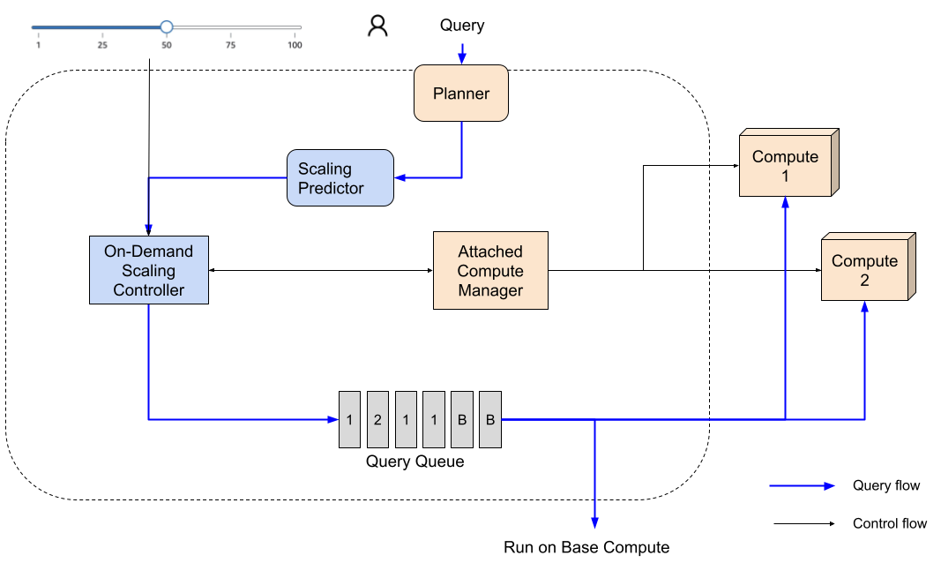
Challenge #2: R depends on system state
Notes:
But this is only one way that the workload, or more generally, the cluster state, affects our decisions. For example, we have to care about what pieces of compute are already attached and ready to go, since this might change our decision. We also have to look at the queue to see how long an incoming query might have to wait. And we might want to consider which table’s data is already cached locally on which cluster.
Because of this, the scaling controller is central and has visibility into all parts of the system: the user settings, the scaling predictions, which compute resources are attached, and
As I mentioned at the beginning, I left out an entirely complementary part of the system, which is how we decide to resize the base compute. If you’re interested, please see the paper.

Slide 23
Evaluation
Where RAIS does well
Where RAIS doesn’t help
Heterogeneous (mixed) workloads
Changing workloads
Changing table sizes
Static, uniform workloads
Workloads with poor scalability
Notes:
So it’s clear that intelligent scaling can really help us if we have heterogeneous workloads consisting of large and small queries with different scalabilities. Combined with an automatic vertical resizing of base, we also do well on workloads that change over time or tables that grow in size over time.
However, where our system does not offer improvements are the “uninteresting” workloads – the ones that have poor scalability and not much query diversity. It’s hard to offer improvement by scaling queries in these situations. In these cases, we don’t regress the workload, but we also don’t really help.

Slide 24
Performance on Mixed Workloads
Baseline (32 RPU + concurrency scaling)
Baseline (256 RPU)
RAIS (32 RPU Base + 256 RPU diagonal scaling)
Notes:
Let’s take a look at how our system does on mixed workloads. Here’s a synthetic workload designed to mimic a common pattern we observe – there is a background flow of short queries and a few (in our case 6) long queries that start arriving in the middle.
On the left, the workload is running on our baseline (Redshift without intelligent scaling) on a small base compute. The large queries block the cluster, cause queuing, and horizontal scaling to balance the extra load. The low billing rate of this compute size is offset by the fact that we need multiple extra compute resources to load balance.
In the middle, is the workload running on a large base compute baseline. This handles the workload easily but it’s also 8x more expensive.
On the right is our solution – we run most of the workload on the small compute but scale up to the big compute when the long queries arrive.

Slide 25
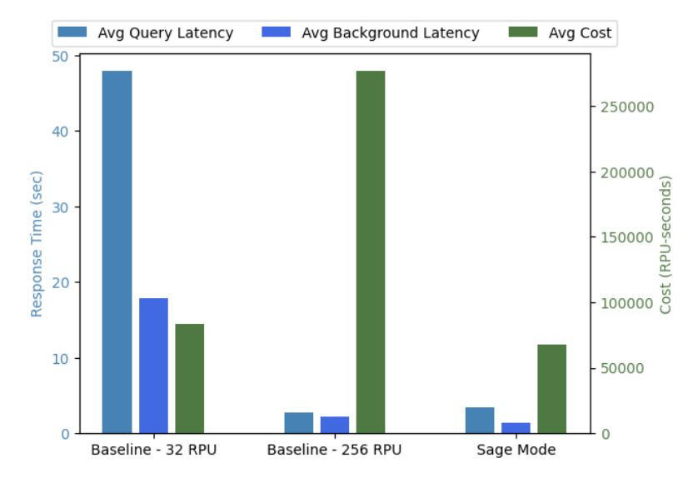
Performance on Mixed Workloads
Baseline (32 RPU + concurrency scaling)
Baseline (256 RPU)
RAIS (32 RPU Base + 256 RPU diagonal scaling)
RAIS
Notes:
Here’s how the cost and performance break down. Green is the cost, the light blue is average query latency, and the dark blue bar is the latency of the background workload – remember these are short queries like those used to populate a dashboard. We don’t want them to take too long.
Notice that with scaling, we can save cost compared to even the small base-compute baseline – this is because we need to spin up more clusters and run the workload for longer to drain the queue. At the same time, we can maintain performance that’s more or less on par with the large compute.

Slide 26
Tips for building ML into systems:
With ML models, we can’t guarantee output quality on every input
Focus on knowing when the output is bad OVER trying to make the output perfectly accurate
Focus on learning from mistakes over zero shot accuracy. Model quality on new inputs matters much less if we take advantage of query repetition. See Redset [1] for real production workload stats.
ML models do not work in isolation. They require well-crafted context, input, and guardrails. Spend your time figuring out how to continuously collect and maintain the right instance-specific information over fine-tuning your global model.
[1] A. van Renen, et al. “Why TPC is not enough: An analysis of the Amazon Redshift fleet”

Slide 27
Thank you!
Please reach out to me if you have questions, are looking for job opportunities (we’re hiring!), or just want to connect!
www.amazon.science/research-areas/cloud-and-systems
vrnathan@amazon.com
www.linkedin.com/in/vikram-nathan/

