Slide 1
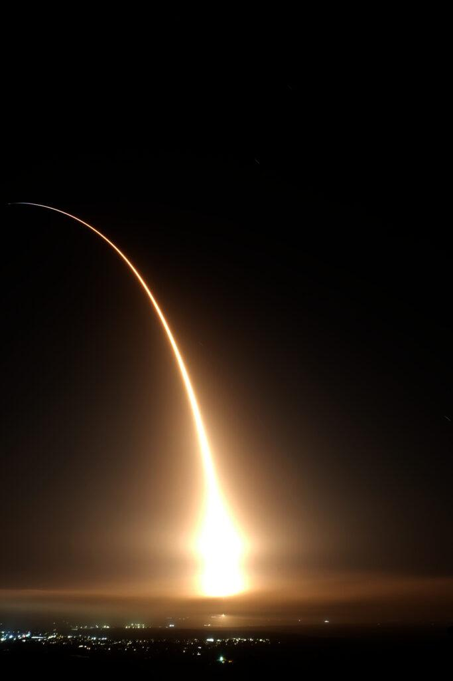
Shipping up to Space
itu.dk
Robert Bayer
HPTS, Gong show
16th September 2024
rad.itu.dk
itu.dk
dasya.itu.dk

Slide 2
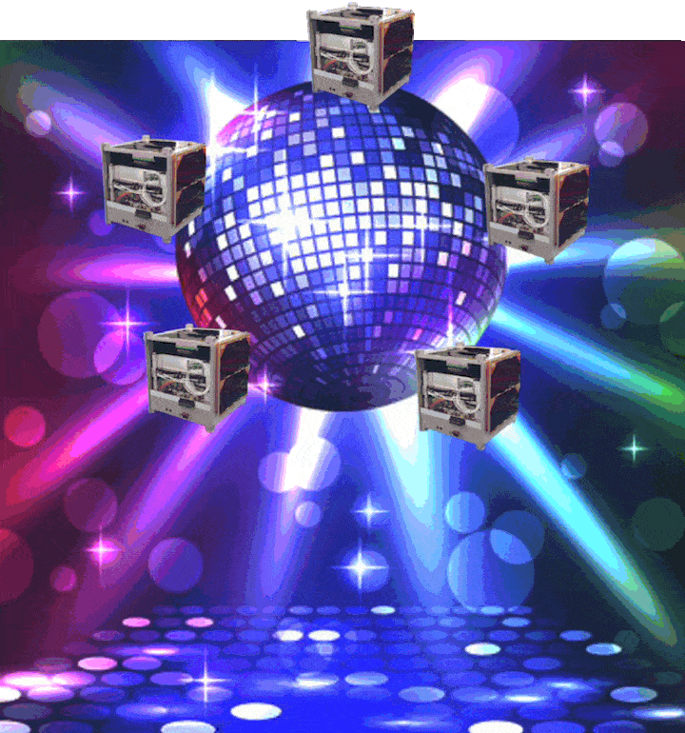
DISCO: Danish Student CubeSat Organization

Slide 3
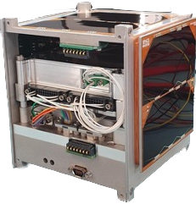
Small Satellites
Benefits
Compromises
Shrinking
+
Standardization
Reduced Power Generation
Reduced cost

Slide 4
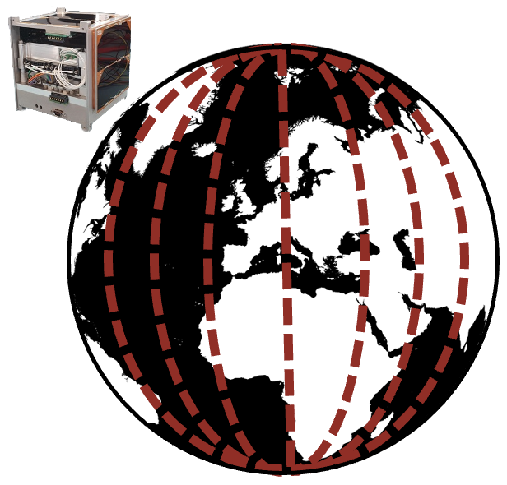
Challenge
<5W
MAX
Can transfer MAX 49.1 images / day
Real-time imaging
4.42 s latency per image
19,547 images
captured / day
<2W
AVG

Slide 5
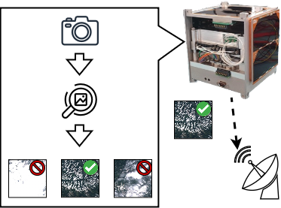
Solution - Machine Learning on Satellite
Our goal: Determine the right edge device to deploy on the satellite for this task.

Slide 6
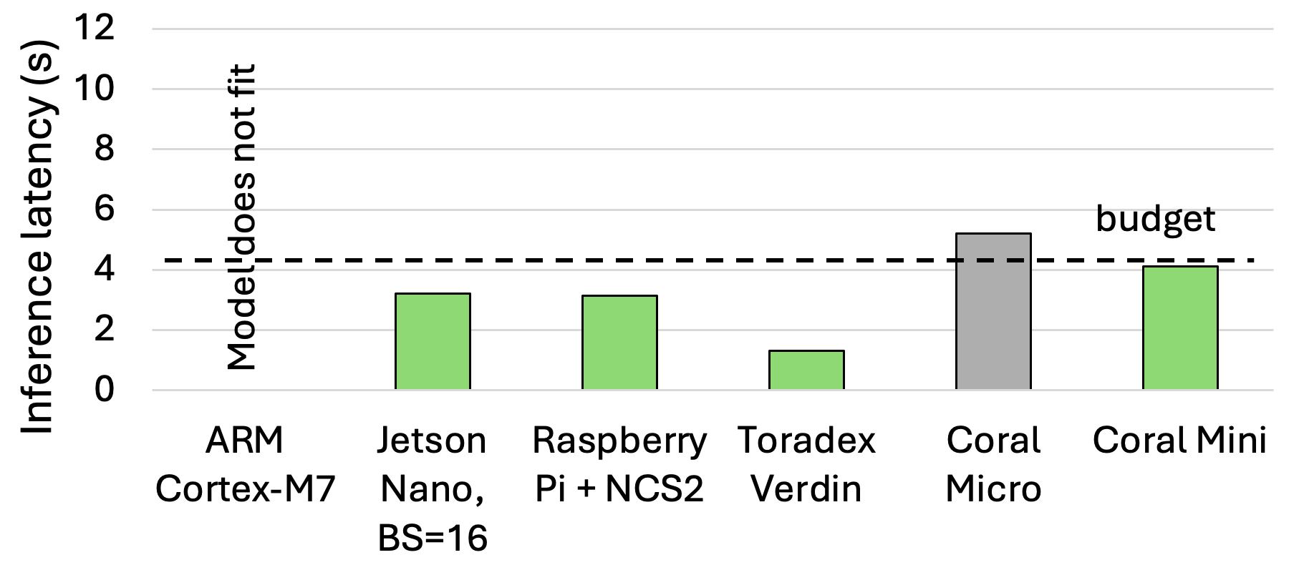
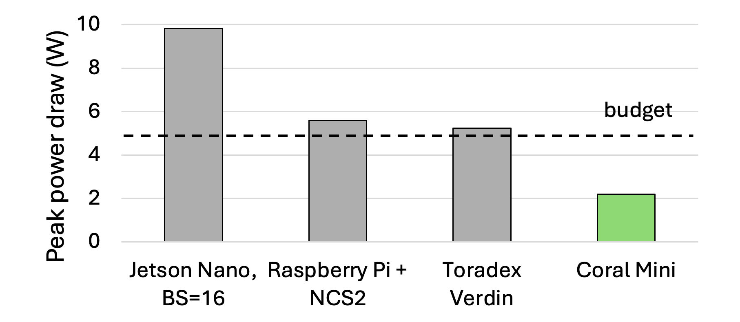
Results
Must check both latency & power!
Coral Mini best candidate!

Slide 7
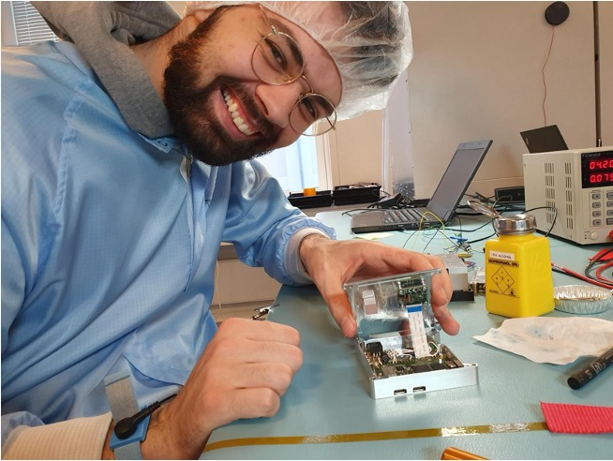
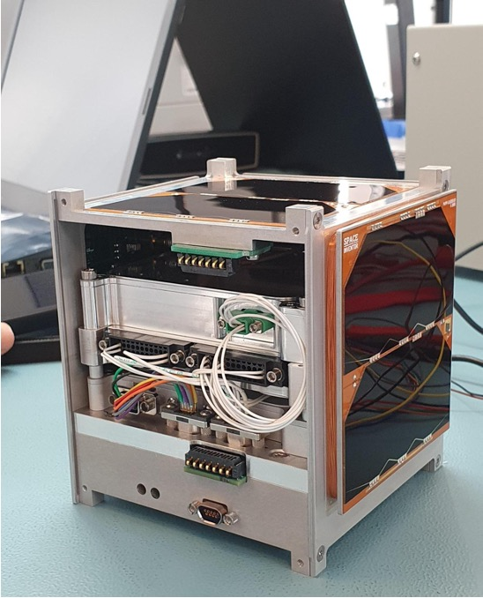
Coral Dev Board Mini launched on board DISCO1 in April 2023

