Slide 1
Sharing Data Loading
Ties Robroek

Slide 3
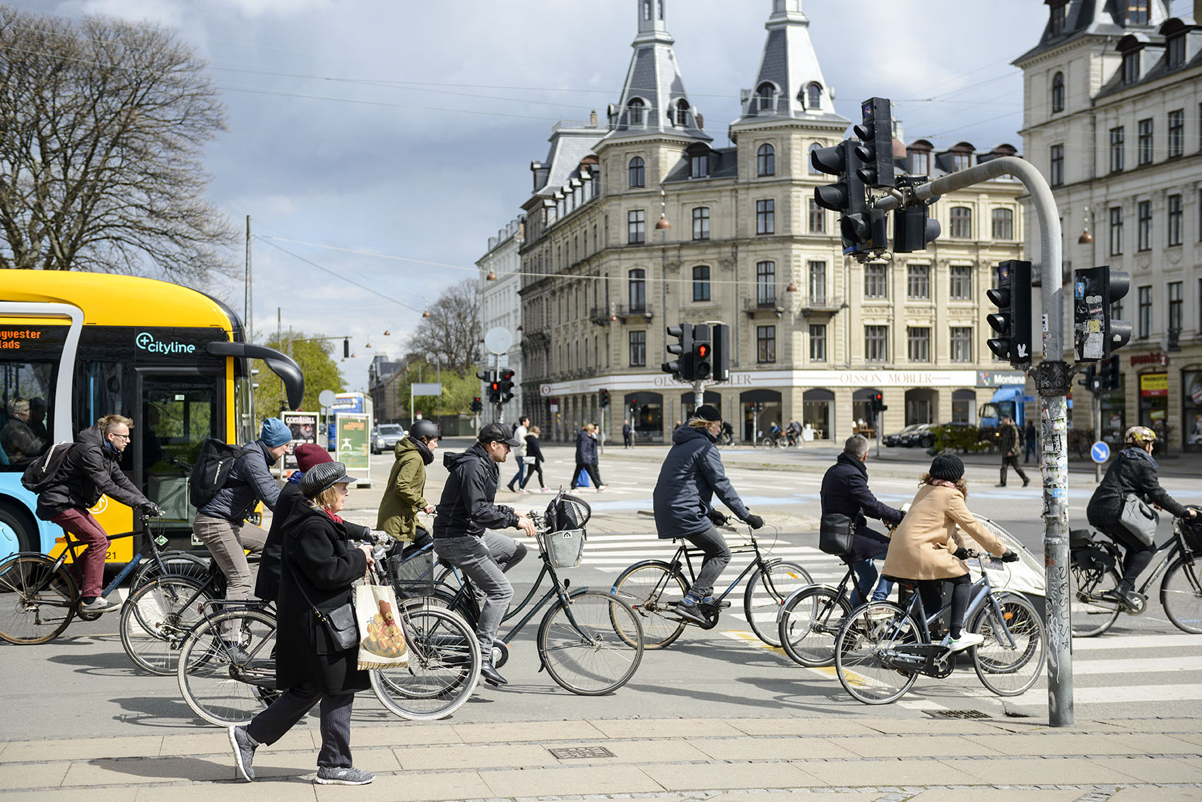
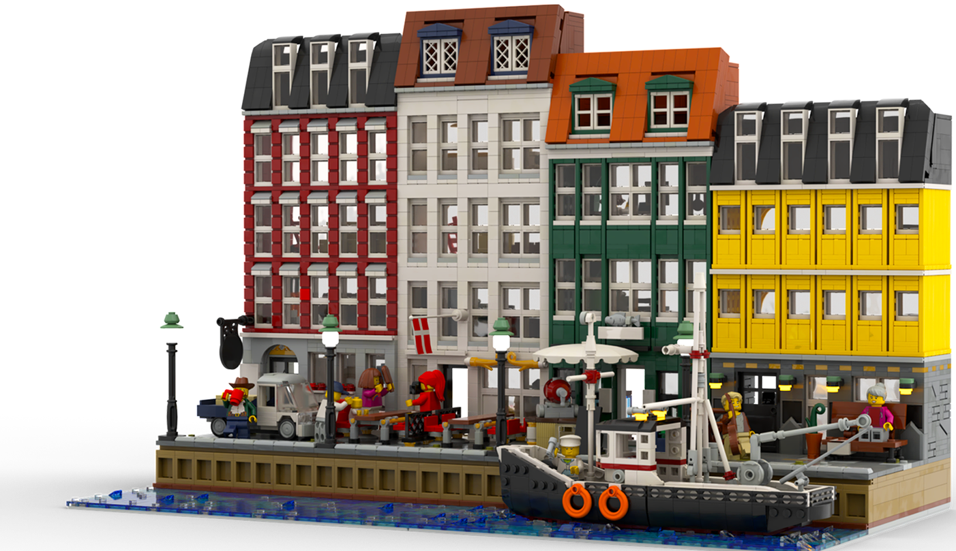
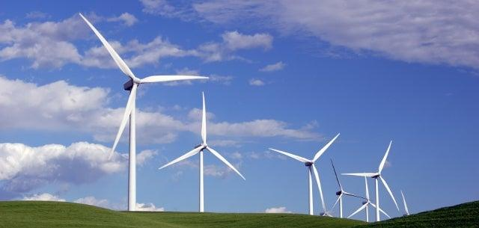

Slide 4
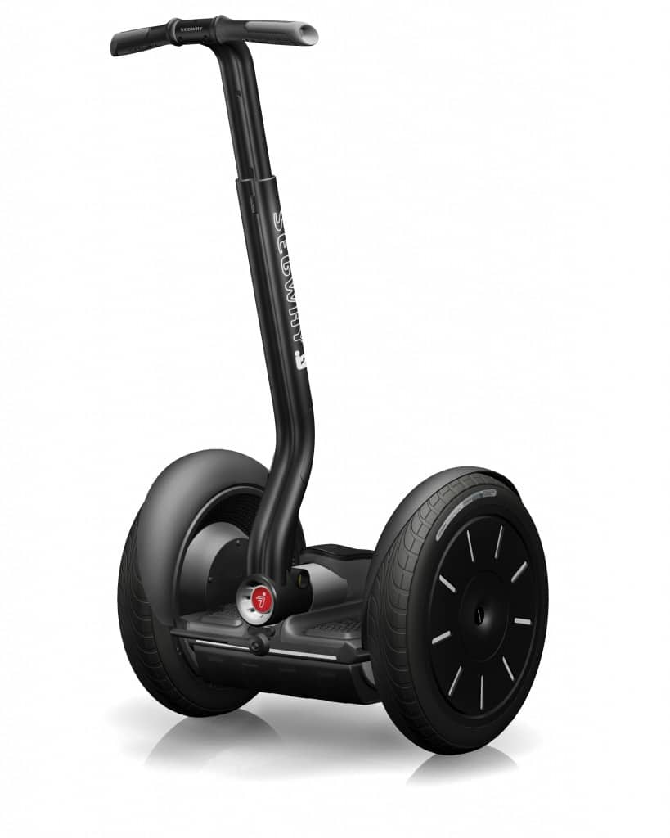

Slide 5
Shared Data Loading

Slide 6
Solo Data Loading

Slide 7
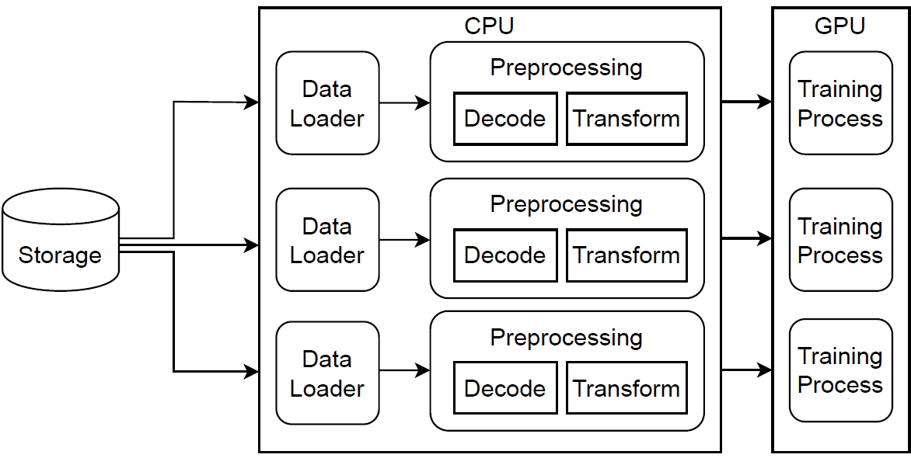
Not Communicating :(

Slide 8
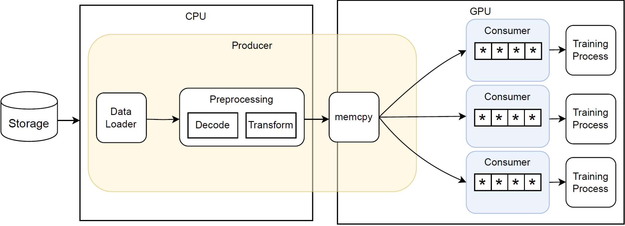
TensorSocket: Communicating and Sharing!

Slide 9
Competitor suffers from overhead!
https://github.com/Resource-Aware-Data-systems-RAD/tensorsocket

